Slide 1
First Letter of your last name: D
Your Full Name: Wyatt Duberstein
I promise I do not cheat on the exam. Your initial: WD
COM S 363: Exam 3
NOTES:
This is an open book open note exam.
You must work by yourself, without discussing with anyone else except TAs or instructors.
You can handwrite, but you are strongly encouraged to type/draw on these slides directly. Some shapes may be given for your convenience. If you do handwrite, write legibly; if the grader can't read, at their sole discretion, you receive no point.
The spaces you are given are more than enough. But if you need more, you can create new slides.
Submit your file in PDF format.
Problem | Max Points | Points
1 | 15
2 | 10
3 | 8
4 | 7
5 | 10
6 | 6
7 | 10
8 | 10
9 | 10
10 | 7
11 | 7
Total | 100

Slide 2
(15 points) Consider an ONLINE AUCTION database system in which members (buyers and sellers) participate in the sale of items. The data requirements for this system are summarized as follows:
The online site has members, each of whom is identified by a unique member number and is described by an e-mail address, name, password, home address, and phone number.
A member may be a buyer or a seller, or both, or not at all. A buyer has a shipping address recorded in the database. A seller has a bank account number and routing number recorded in the database.
Every item must have one and only one seller. They are placed by a seller for sale and are identified by a unique item number assigned by the system. Items are also described by an item title, a description, starting bid price, bidding increment, the start date of the auction, and the end date of the auction.
Buyers make bids for items they are interested in. Bid price and time of bid is recorded.
A bidder at the end of the auction may be declared the winner of an item. An item can have only one winner.
When a winner is declared, the buyer and seller may record feedback regarding their experience on the sale process. Feedback contains a rating of the other party participating in the transaction (1-10) and a comment.
Draw an ER diagram that captures all attributes of each entity set and each relationship set for the above requirements. Specify the key for each entity set and all the constraints for each relationship set. Specify any necessary overlap and covering constraints (in English). Use the ER notations introduced in our lectures.
Please draw your diagram in the next slide. The notations below are provided for your convenience. They are not meant to be complete, nor will you need all of them.
m
u
isa

Slide 3
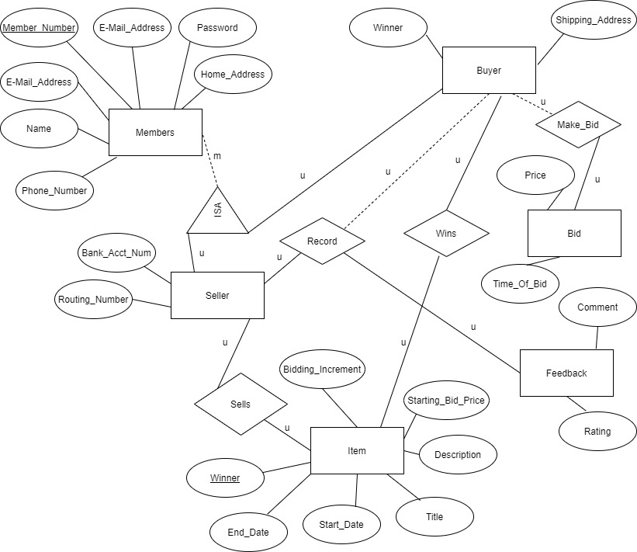
Draw your ER diagram on this slide

Slide 4
(10 points) Convert the following E-R diagram into a set of relations. For each relation, use SQL's "create table" to specify its name, attributes, and constraints (i.e., key, primary key, and foreign key). You have the flexibility to specify types for the attributes, but you will lose points if your grader thinks it does not make sense (e.g., defining “title” as num).
Write your answers on the next slide.

Slide 5
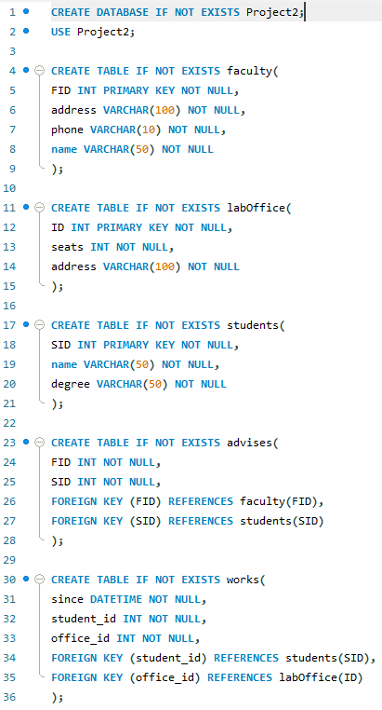
Write your answers on this slide

Slide 6
(8 points) We have the following relations.
Students
Departments
Degrees
Majors
Minors
Courses
Continue to next page ….

Slide 7
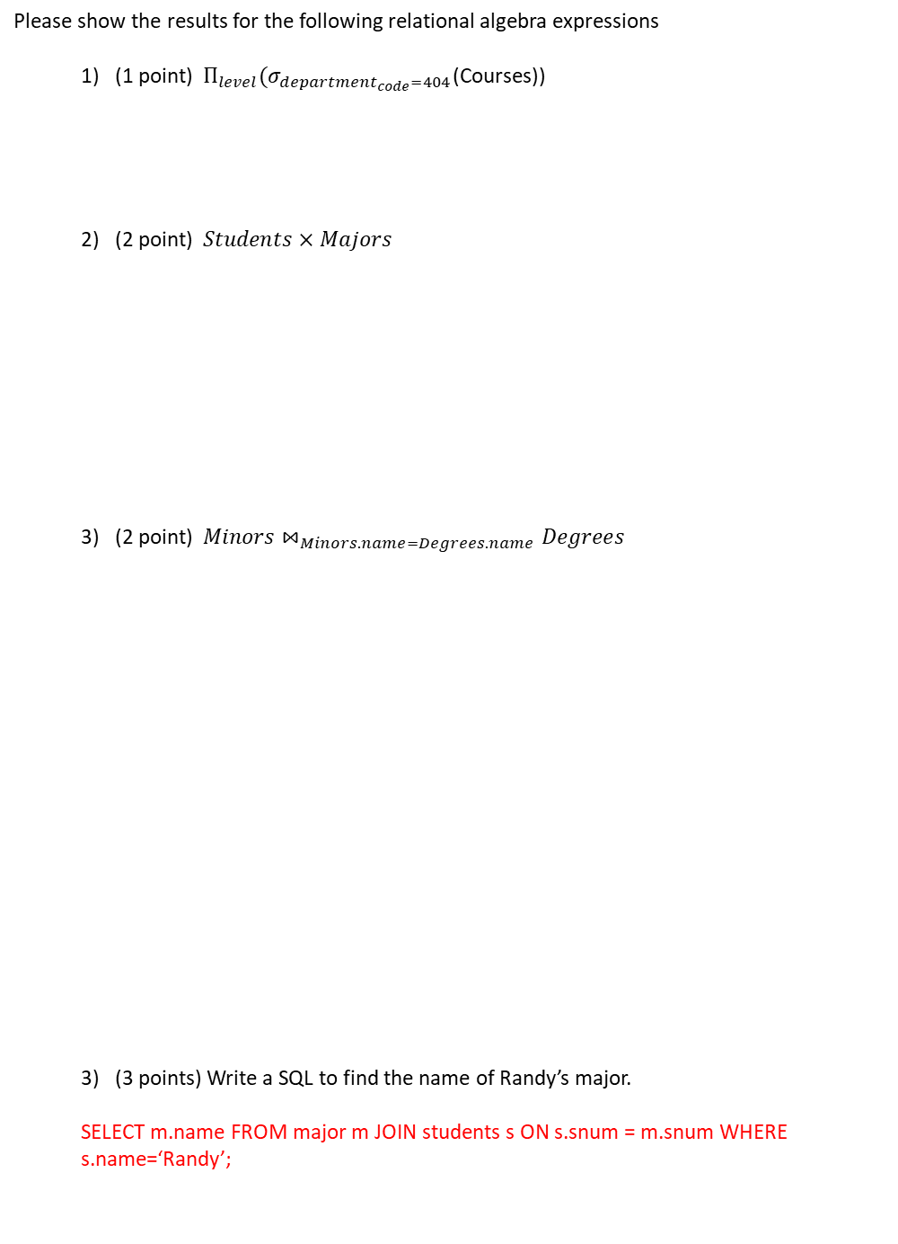
(continue from the previous page)
Please show the results for the following relational algebra expressions
(1 point) $Π_{level}(σ_{department_{code}=404}$(Courses))
(2 point) $Students×Majors$
(2 point) ${Minors⋈}_{Minors.name=Degrees.name}Degrees$
(3 points) Write a SQL to find the name of Randy’s major.
SELECT m.name FROM major m JOIN students s ON s.snum = m.snum WHERE s.name=‘Randy’;
level
undergraduate
snum | name | gender | name | level
1001 | Randy | M | Computer Science | BS
1005 | Nicole | F | Applied Mathematics | MS
snum | name | level | name | level | department_code
1001 | Computer Science | BS | Computer Science | BS | 401
1001 | Computer Science | BS | Computer Science | MS | 401
1001 | Computer Science | BS | Computer Science | PhD | 401
1005 | Applied Mathematics | MS | Applied Mathematics | MS | 402
Continue to next page ….

Slide 8
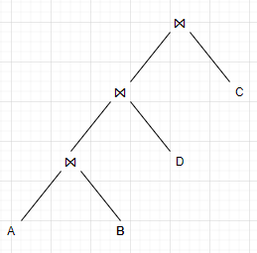
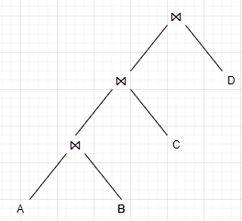
(7 points) Finding the best plan for join operations is prohibitively expensive. A practical solution is to avoid the worst plans by considering only the left-deep plans.
a) (2 points) Explain the main benefit of left-deep plans.
There are a few benefits. One is that there is a reduced memory requirement for left-deep plans and the search space is reduced as well.
b) (5 points) Consider joining 4 relations A, B, C, and D. Suppose A ⋈ B is known to have the least disk I/Os among the joins of any two relations. Given this information, draw all possible left-deep join trees that will be considered by IBM System R.

Slide 9
(10 points) Derive the minimum time cost of a block nested loops join of relations R and S given the following variables, which you may or may not use all of them. Ignore the CPU time costs. R is the outer relation and the results of the join are written back to the disk.
|R|: Number of tuples in R
|S|: Number of tuples in S
M: Number of pages in R
N: Number of pages in S
B: Number of available memory in pages
P: Number of pages that the join results occupy
Cr: Time cost of reading a page from disk into memory in seconds
Cw: Time cost of writing a page from memory into disk in seconds
a) (4 points) The total time cost of loading R into memory
M + (M / (B – 2)) * N
b) (4 points) The total time cost of loading S into memory
N * Cr
c) (2 points) The total time cost of writing results to the disk
(M+N)*Cw

Slide 10
(6 points) Explain how to sort 30 pages of data (e.g., numbers) with 3 pages of main memory in detail (i.e., pass 1, pass 2, ..., until the data is sorted) and estimate the I/O cost. Your algorithm needs to minimize disk I/Os (i.e., the number of pages that need to be read from and written to the disk). When sorting in main memory, you can assume you have the additional memory for swapping two numbers.
1. Read 3 pages into main memory and sort using any method, such as quicksort.
2. Write the data from part 1 to disk.
3. Repeat steps 1 and 2 until all the data is sorted in 3-page chunks
4. Read the first page of each group of data into input buffers and save 1 page for the output buffer. This is to merge the data into 1 output file for the system.
5. Merge the data and store the result in the output buffer.

Slide 11
7. (10 points) For each of the following schedules, determine what schedule(s) it is.
S1
T1
R(A)
W(A)
commit
T2
W(A)
commit
S1 is a serial schedule. Yes[] No[X]
S1 is a strict schedule. Yes[ ] No[X]
S1 is a serializable schedule. Yes[ ] No [X]
S2
T1
R(A)
W(A)
commit
T2
R(B)
W(B)
commit
S2 is a serial schedule. Yes [X] No[ ]
S2 is a strict schedule. Yes [X] No[ ]
S2 is a serializable schedule. Yes [X] No[ ]
S3
T1
R(A)
R(B)
W(A)
commit
T2
W(B)
commit
T3
R(A)
commit
S3 is a strict schedule. Yes[ ] No [X]
S3 is a serializable schedule. Yes [X] No[ ]
S3 is a recoverable schedule. Yes [X] No[ ]

Slide 12
8. (10 points) Strict 2PL uses a lock table to track 1) which data object is locked; 2) which transaction owns which lock; 3) which transaction is waiting for a lock on which object. Consider the following schedules. For each step of their execution, write down the status of the corresponding lock table. An execution can result in deadlock. When this happens, you write own “deadlock” and ignore the rest steps.
1) T1.S(A)
S
Data | Lock | Owner | Waiting
A | S | T1
T1
S(A)
R(A)
X(A)
W(A)
commit
T2
S(A)
R(A)
X(A)
W(A)
commit
2) T2.S(A)
Data | Lock | Owner | Waiting
A | S | T1,T2
3) T1.R(A)
Data | Lock | Owner | Waiting
A | S | T1,T2
4) T1.X(A)
Data | Lock | Owner | Waiting
A | X | T1 | T2
5) T2.R(A)
Data | Lock | Owner | Waiting
A | X | T1 | T2
6) T1.W(A)
Data | Lock | Owner | Waiting
A | X | T1 | T2
7) T1.commit
Data | Lock | Owner | Waiting
A | S | T2
8) T2.X(A)
Data | Lock | Owner | Waiting
A | X | T2
9) T2.W(A)
Data | Lock | Owner | Waiting
A | X | T2
10) T2.commit
Data | Lock | Owner | Waiting

Slide 13
9. (10 points) For better current execution, multiple-granularity locking (MGL) introduces three new types of locks, IS, IX, and SIX. Consider the following tree of objects, where each node contains all its children. Note that some nodes have been locked by other transactions and the types of locks are given nearby.
db
IS, IX
IX
f1
f2
IS
IX
p1
p2
S
p3
X
r1
r2
r3
r4
r5
r6
r7
a) (5 points) Transaction T1 needs to read object r3. What lock(s) on which node(s) does it need to acquire? For each lock, specify if it will be granted.
db(IS) yes, f1(IS) yes, p1(IS) yes, r3(S) yes
b) (5 points) Transaction T2 needs to write object r6. What lock(s) on which node(s) does it need to acquire? For each lock, specify if it will be granted.
Since p3 is locked with an S lock, the S lock would have to unlock from there and move in the direction of the root node. It would then do the schedule as follows:
db(IX) yes, f2(IX) yes, p3(IX) yes, r6(X) yes

Slide 14
10. (7 points) Consider the following spatial objects (located inside the red rectangles) and the corresponding R-tree built for these objects.
R
Q
a) (3 points) Suppose we want to retrieve the spatial objects located in the window Q. What node(s) in the R-tree will be accessed?
Node(R1-R2)
Node(R3, R4, R5)
Node(R6-R7)
Node(R8, R9, R10)
b) (4 points) Suppose we want to insert a spatial object located in R. What rectangle(s) in the R-tree must be updated?
Node(R1-R2)
Node(R3, R4, R5)

Slide 15
11. (7 points) Consider the following transactions from a grocery store.
Transaction ID | Items
T1 | HotDogs, Buns, Ketchup
T2 | HotDogs, Buns
T3 | HotDogs, Coke, Chips
T4 | Chips, Coke
T5 | Chips, Ketchup
T6 | HotDogs, Coke, Chips
a) (2 points) Compute the support of Ketchup
Ketchup -> 33.3%
b) (2 points) Compute the support and the confidence of the following associate rule: Coke→Chips & HotDogs.
Support = 2/6 = 33.3%
Confidence = 2/3 = 66.7%
c) (3 points) Suppose {HotDogs}, {Coke}, and {Chips} are frequent 1-itemset. List all candidates for frequent 2-itemset.
{HotDogs, Coke} {HotDogs, Chips} {Coke, Chips}

